Slide 1


MOI Hackathon
Service Accessibility
Done by: White Hat Team

Slide 2
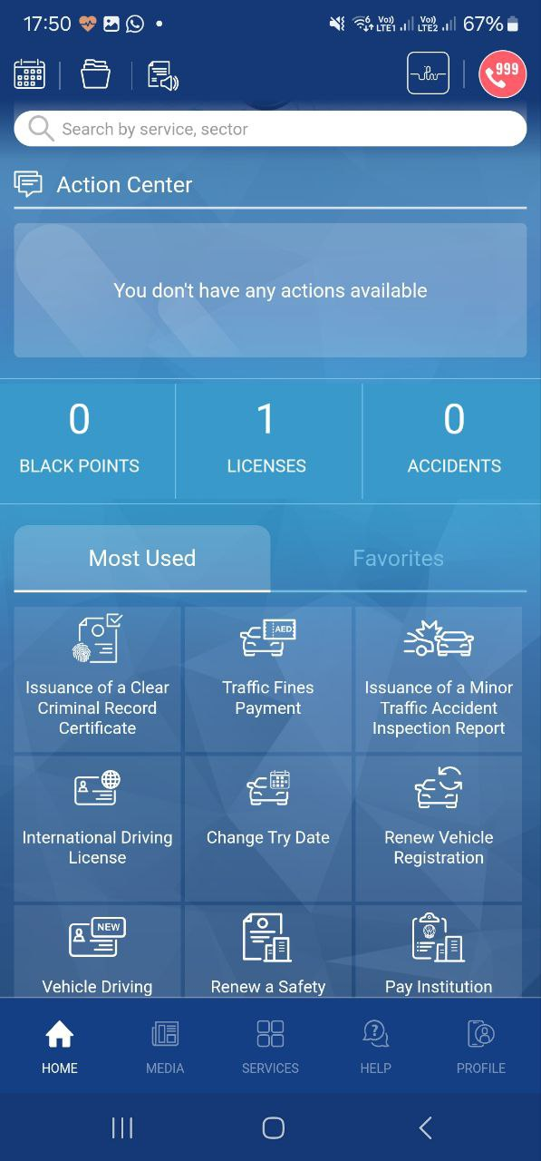
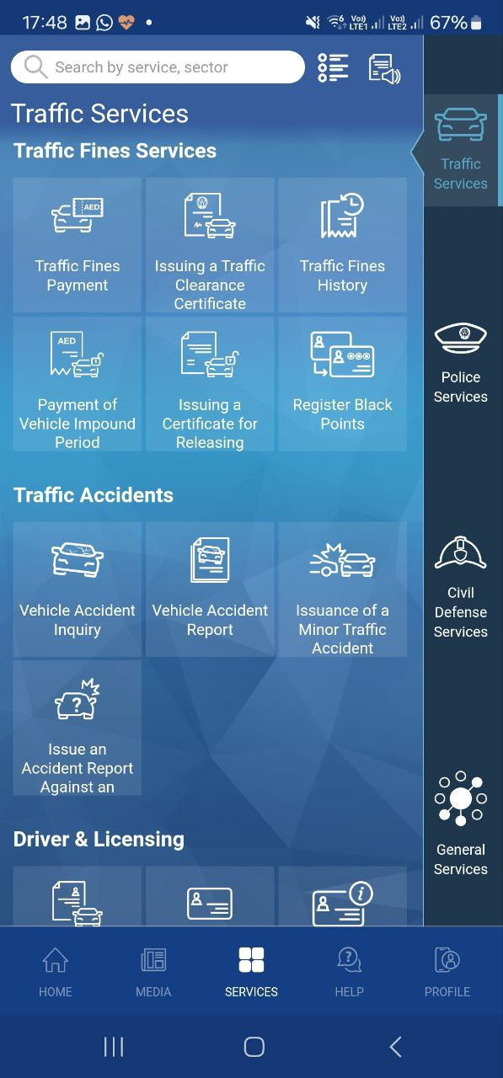
Accessibility Challenge

Slide 3
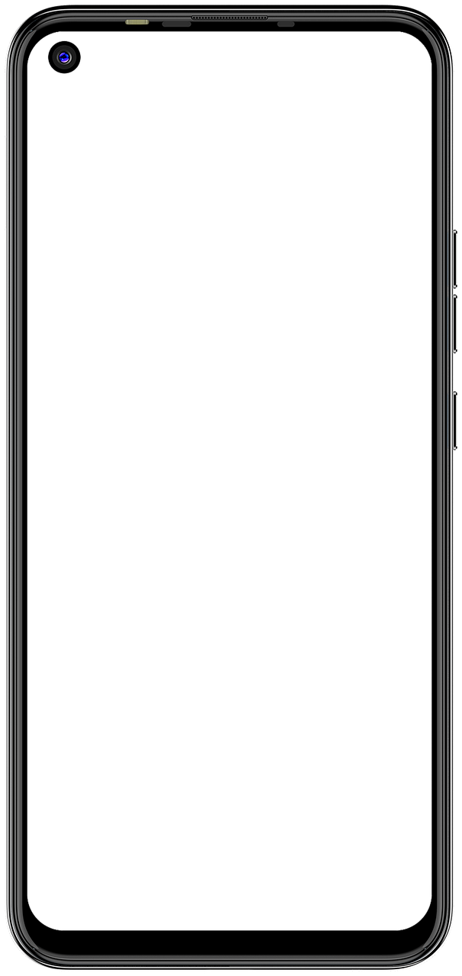
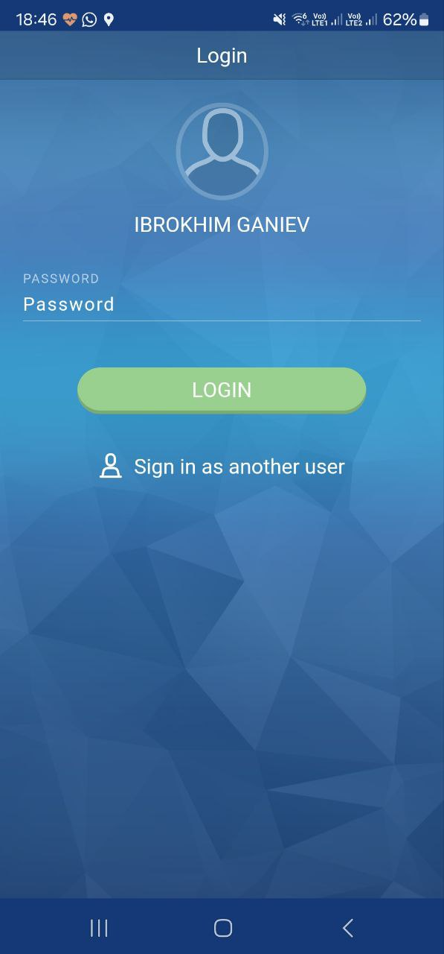
Solution
Develop a tutorial guide resembling a game interface
Incorporate interactive elements
Offer step-by-step walkthroughs and achievement badges for progress

